Slide 1

Plant Disease Detection
using CNN
DURAN DUMAN 190101037

Slide 2
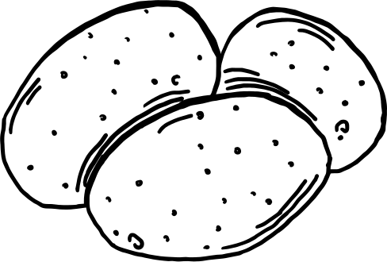

Purpose of the Project
This project aims to develop a deep learning model to automatically detect diseases using potato plant data from a dataset containing many plant species.
The project analyzes images of plant leaves using one of the deep learning techniques, ,Convolutional Neural Network (CNN) which is designed to process and analyze visual data like images and videos. It automatically detects important features and patterns using layers of convolutional filters, making it highly effective for tasks such as image recognition and classification
The model will be able to learn and detect healthy potato plants as well as images containing symptoms of common potato diseases.

Slide 3
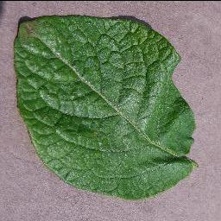
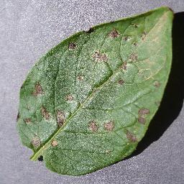
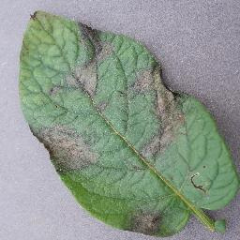
Dataset Overview
Dataset name: New Plant Disease Dataset
Source: Kaggle
Plant used: Potato
This dataset consists of approximately 87K rgb images of healthy and diseased plant leaves, divided into 38 different classes.
For the project, only images containing potato diseases were used.
The potato data consists of three classes: "potato early blight", "late blight" and "healthy".
To use these diseases, I used the dataset as 5632 train, 1440 validation.
Each Image data has the size of 256x256.

Slide 4
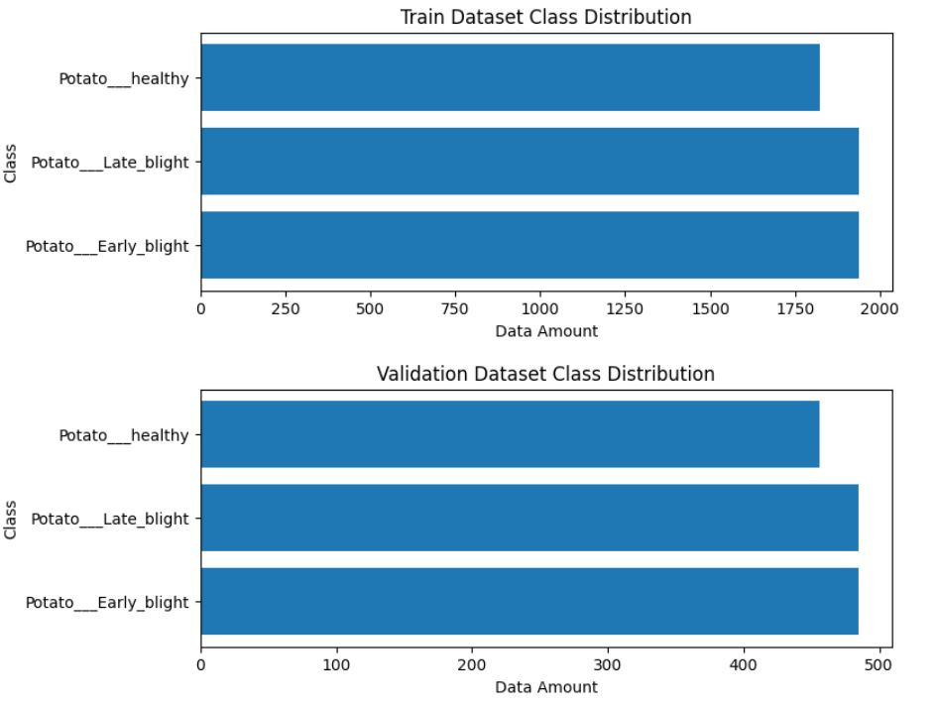
Dataset Distribution

Slide 5
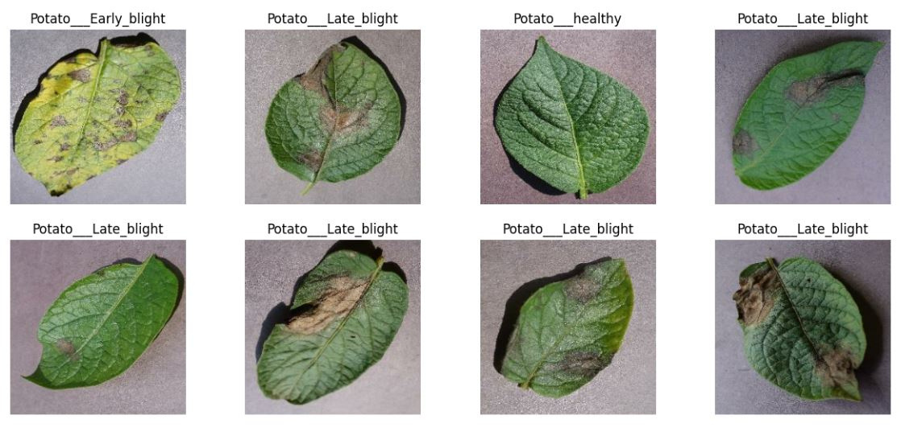
Data Visualization
I selected a few images from each class to visualize the dataset.
This step included displaying images labeled as Early Blight, Late Blight, and Healthy.

Slide 6

Splitting the Validation Dataset
The validation dataset was further partitioned into validation and test sets to evaluate the model more effectively.
The validation set comprised 80% of the original validation dataset, while the test set comprised the remaining 20%.
This resulted in 36 batches for validation data and 9 batches for test data. (Batch Size : 32)
A batch refers to a subset of the dataset that is processed together during one iteration of training.

Slide 7
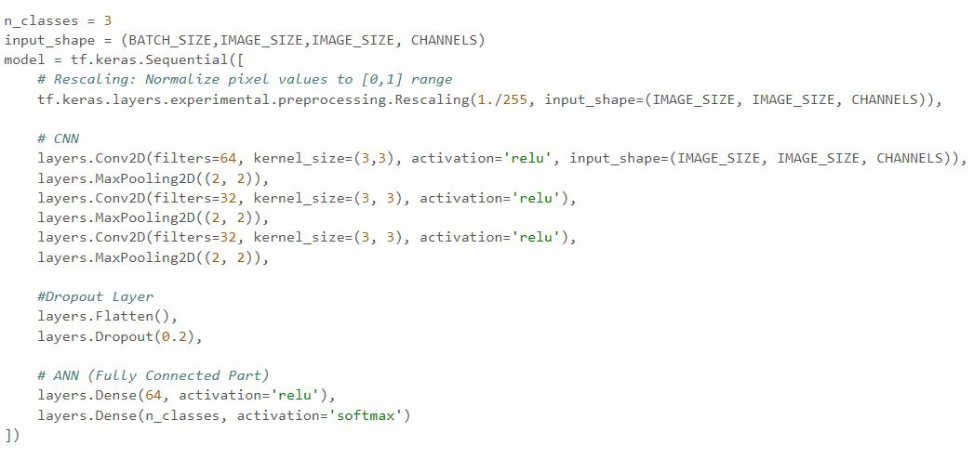
Model Architecture
The CNN model architecture was designed with the input shape of (256, 256, 3) and aimed to classify images into the three disease categories.
Layer Details
Rescaling Layer: Normalizes pixel values to [0, 1].
Ensures consistent input by scaling pixel values from 0-255 to a normalized range suitable for training.
Convolutional Layers: Extracts features using multiple filters.
Filters slide over the input image to extract different features like edges or textures
MaxPooling Layers: Reduces dimensions to capture essential features.
Downsampling feature maps to capture essential information and reduce computational complexity.
For building the model, I used the following layers,
Dropout Layer: decreases overfitting by randomly dropping neurons during training.
Fully Connected Layers: Performs classification based on extracted features.
Dense layers integrate extracted features to classify images into disease categories.

Slide 8
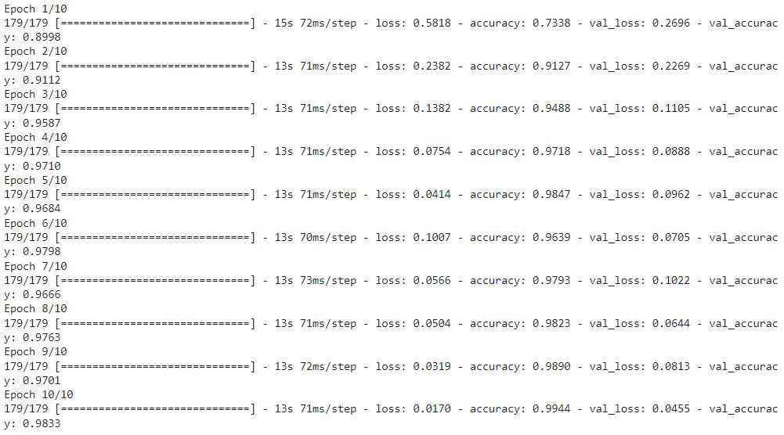
Training the Model
The model was compiled with the Adam optimizer, categorical crossentropy loss function, and accuracy metrics.
Training process was done in 10 epochs.

Slide 9
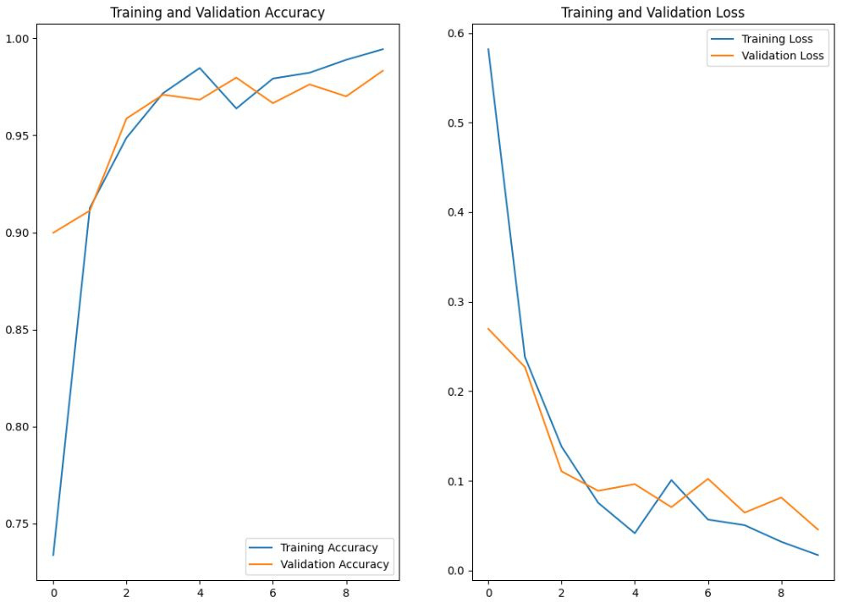
Evaluate the Model
Graphs depicting training and validation accuracy, as well as loss, were plotted to visualize model performance over epochs.

Slide 10
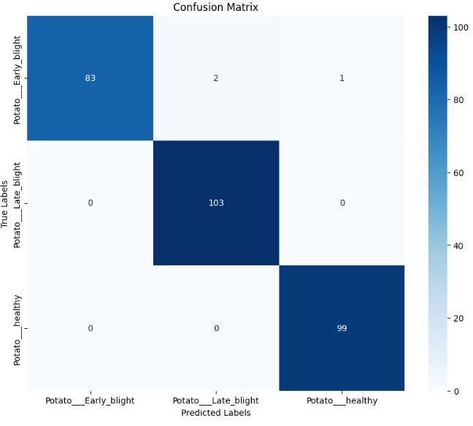
Testing the Model
The model's performance was evaluated using the test dataset, achieving an accuracy of 98.96%.
A confusion matrix was generated to visualize the classification results across different classes.

Slide 11
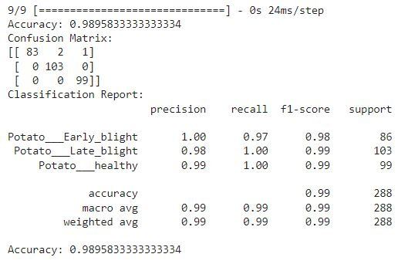
Performance Metrics
Precision, recall, and F1-score metrics were calculated and presented in a detailed classification report for each class.
Precision
TP / (TP + FP)
Recall
TP / (TP + FN)
F1-Score
2 * (precision * recall) / (precision + recall)

Slide 12
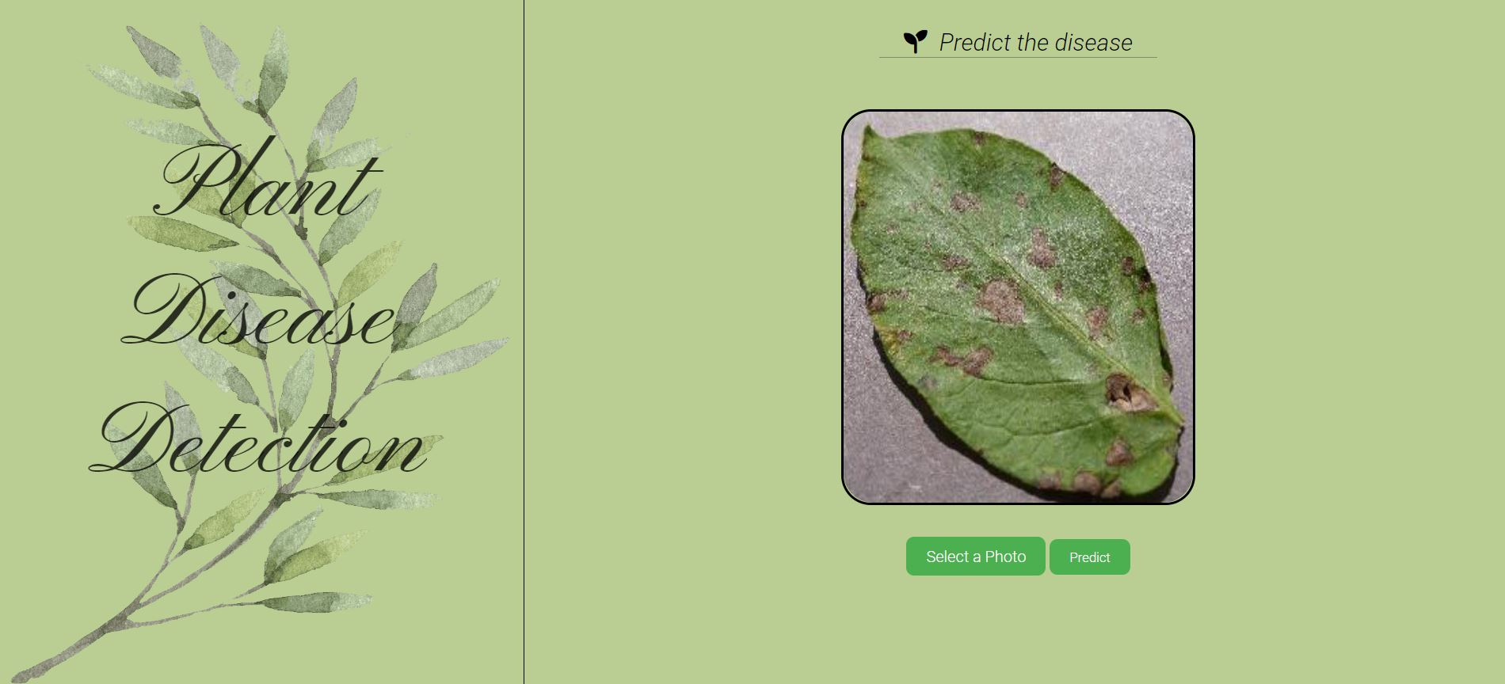
WebPage with Flask Backend

Slide 13
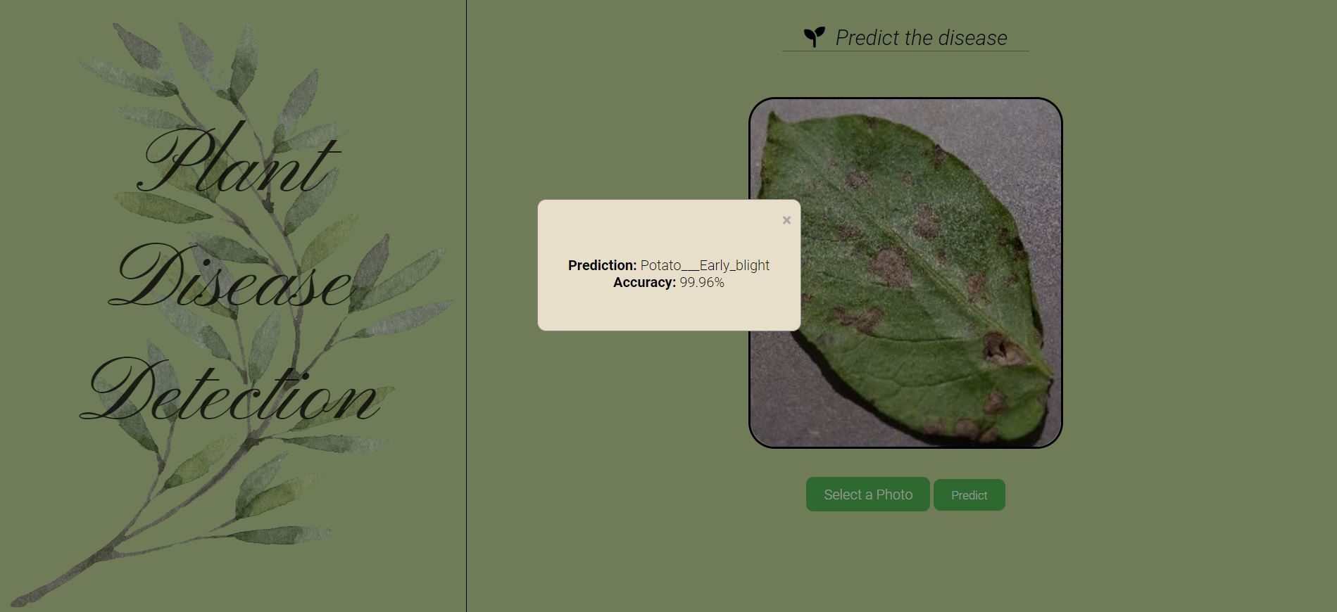

Slide 14
Thank You for Listening

